Slide 1
CROP PRODUCTION ANALYSIS
COUNTRY: INDIA
YEAR: 1997 - 2015
EGBOSIMBA CHINENYE

Slide 2
Introduction
Objective: This report provides an in-depth analysis of crop production in India from 1997 to 2015, covering a broad range of crops, their production areas, gross production, seasonal variations, and the specific states and districts where these crops were produced. The primary goal is to predict crop yields and extract key insights, identifying critical indicators that influence crop production.

Slide 3
Data Constituents
The dataset consists of these fields:
District Name
State Name
Crop
Season
Crop Year
Area and
Production

Slide 4
Tools
The data was cleaned with Excel and analyzed and visualized with Power BI.

Slide 5
Data Overview
Dataset Description: The dataset contains 246,091 records and each record represents the production of specific crops over many years and in different regions. The key fields are:
State Name: Crop production states such as Kerala, Sikkim, Tamil Nadu etc
District Name: Production districts such as Kozhikode, Mumbai, Namsai etc
Crop: The name of crops produced such as Rice, Coconut, sugarcane, etc.
Crop year: The year(s) of crop production such as 1997, 2001, 2015 etc.
Season: The season(s) of crop production such as Kharif, Rabi, etc.
Area: Land area dedicated to crop production.
Production: The quantity of each crop produced.

Slide 6
Data Cleaning
Overall Crop Production Summary
Total Production Area: 2,953,703,409.23 billion square meters
Gross Production: 141,000,000,000.00 billion units

Slide 7
Analysis
Top Producing Districts
Kozhikode Utilized 3 million square meters of land and produced 15 billion units (10.82% of total gross crop production).
Malappuram Utilized 3.21 million square meters and produced 14 billion units (10.28% of total crop production).
Thiruvananthapuram Utilized 2.22 million square meters and produced 10 billion units (7.1% of total crop production).
Thissur Utilized 2.45 million square meters and produced 9.9 billion units (7.03% of total crop production).
Kannur Utilized 3.01 million square meters and produced 9.7 billion units (6.93% of total crop yield)

Slide 8
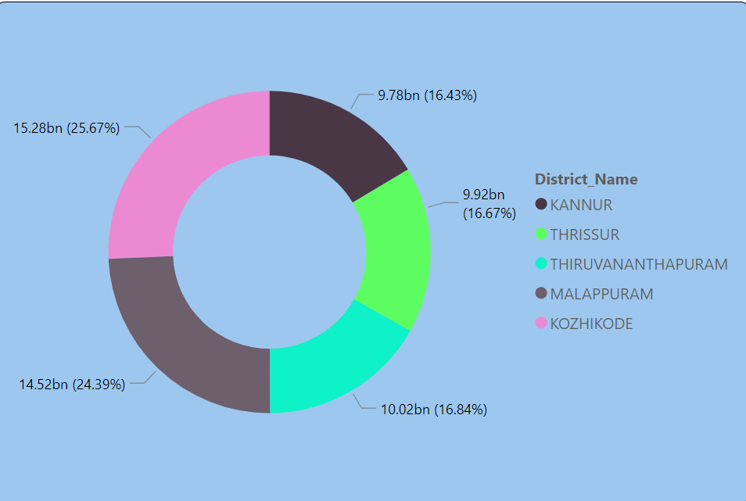

Slide 9
Analysis
Top Yielding Crops
Coconut: 28.38 million square meters produced 129 billion units.
Sugarcane: 76.68 million square meters produced 5.5 billion units.
Rice: 747.13 million square meters produced 1.6 billion units.
Wheat: 470.71 million square meters produced 1.3 billion units.
Potato: 170.66 million square meters produced 424.8 million units.

Slide 10
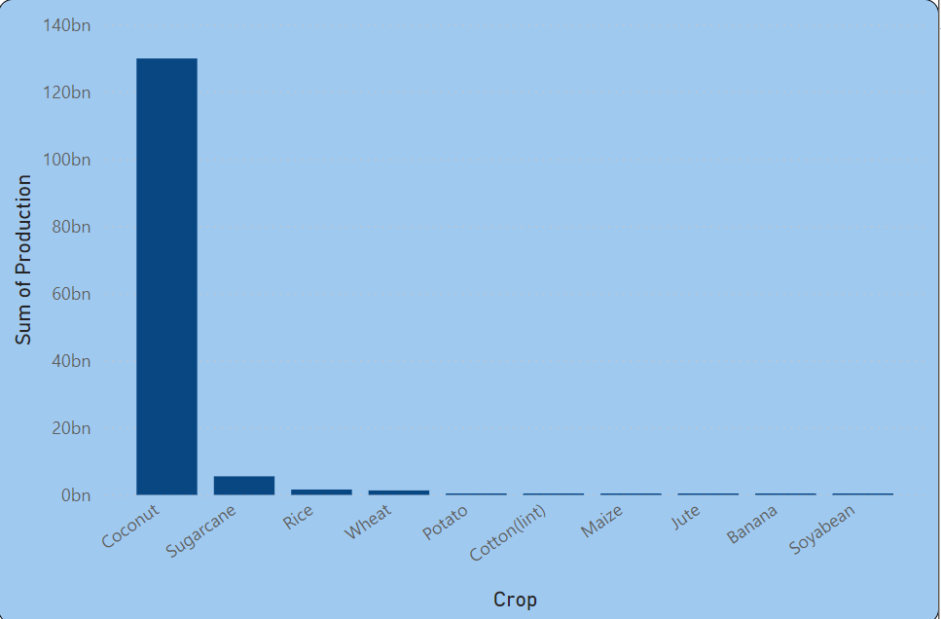

Slide 11
Analysis
Season with highest Crop Yield
Whole-Year Farming Season: Produced 134.42 billion units.
Kharif Season: Produced 4.03 billion units.
Rabi Season: Produced 2.05 billion units.

Slide 12
Analysis
Season with the Lowest Crop Yield
Autumn Produced 64.41 million units, the lowest among all seasons.

Slide 13
Analysis
- Crops with the Highest Land use or Area
Rice Utilized 747 million square meters, yielding 1.61 billion units.
Wheat Utilized 470 million square meters, yielding 1.33 billion units.
Cotton (Lint) Utilized 156 million square meters, yielding 297 million units.
Bajra Utilized 141 million square meters, yielding 129.68 million units.
Jowar Utilized 137 million square meters, yielding 114.60 million units.

Slide 14
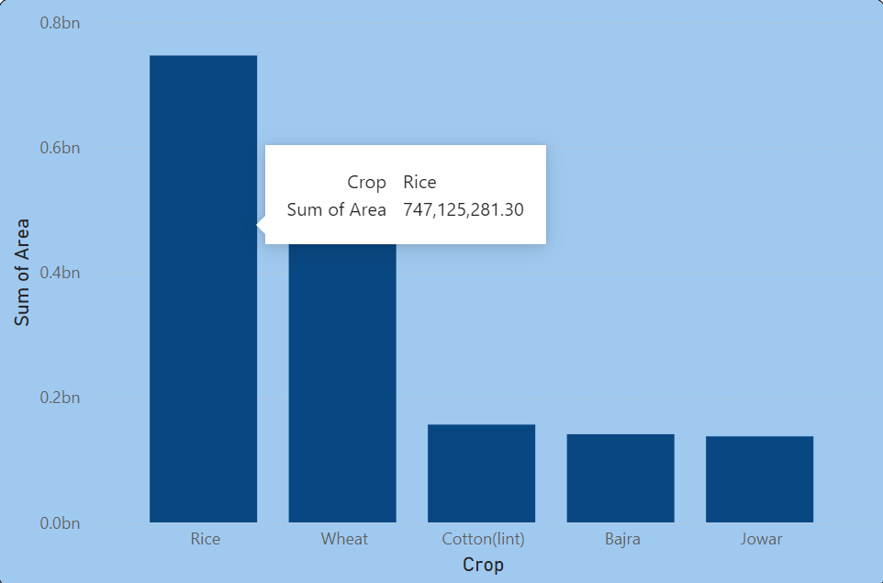

Slide 15
Analysis
The Lowest Yielding Crops
These are some of the lowest yielding crops:
Bitter gourd: Total yield of 353 units, cultivated year-round in Tamil Nadu, Manipur, and Kerala.
Turnip: Total yield of 363 units, cultivated year-round in Tamil Nadu and Jammu and Kashmir.
Bottle gourd: Total yield of 598 units, cultivated year-round in Telangana, Tamil Nadu, Manipur, and Andhra Pradesh.
Jobster: Gross yield of 1180 units, planted only in the Kharif season in Nagaland.
Perilla: Produced a total yield of 1410 units, planted only in the Kharif season in Nagaland.

Slide 16
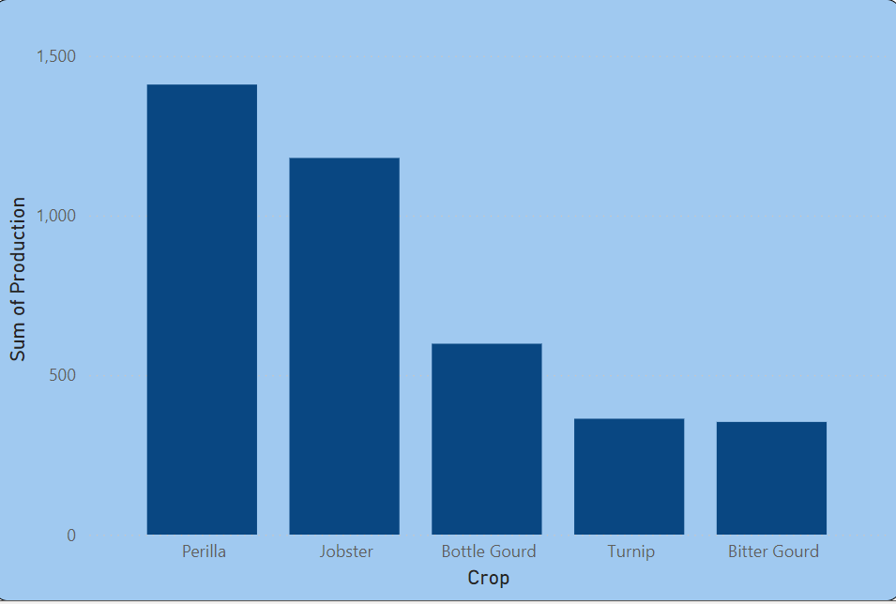

Slide 17
Analysis
- Lowest Crop Producing Districts
These are some the districts with the poorest crop production:
Gulbarga, Karnataka: Contributed 0.02% to total crop production.
Bidar, Karnataka: Contributed 0.02% to total crop production.
Barabanki, Uttar Pradesh: Contributed 0.02% to total crop production.
Ambala, Haryana: Contributed 0.02% to total crop production.
Karnal, Haryana: Contributed 0.02% to total crop production.

Slide 18
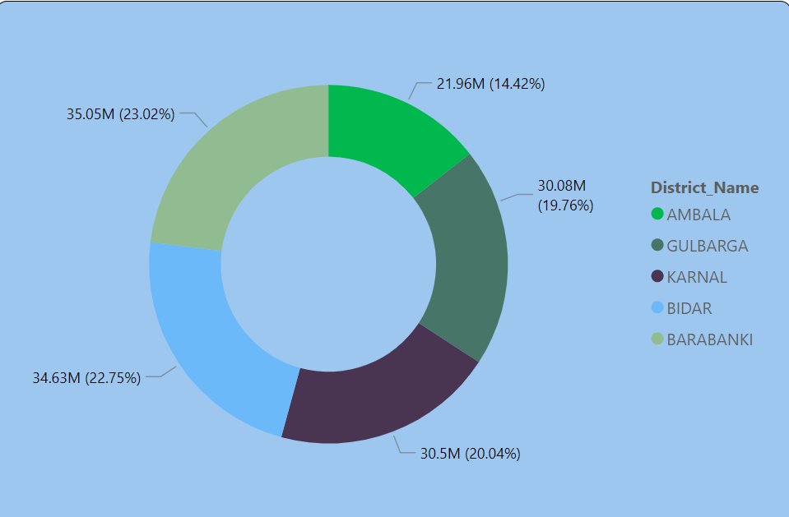

Slide 19
Key Insights
Kerala Dominates Crop Yields
The top five districts with the highest crop yields are all located within Kerala. This suggests that Kerala's agricultural practices, climate, or policies are particularly conducive to maximizing crop production.

Slide 20
Key Insights
Year-Round Farming Increases Yield
Farms that engaged in year-round cultivation achieved the highest crop yields across all planting seasons. This indicates the importance of consistent agricultural activity and resource utilization throughout the year.

Slide 21
Key Insights
Higher Yield Correlates with Larger Land Allocation
Crops that delivered the highest yields were generally planted on larger tracts of land. This suggests that larger-scale operations may have access to more resources, better technology, or optimized farming techniques that allow for higher output compared to smaller-scale operations.

Slide 22
Recommendations
Expand Successful Practices Across Kerala
Agricultural strategies and practices from the top-performing districts in Kerala should be studied and potentially implemented in other regions to boost crop yields across the board. This could involve knowledge sharing, improved access to better seeds, modern farming techniques, and climate-specific adaptations.

Slide 23
Recommendations
Encourage and Support Year-Round Farming
Promote policies and programs that encourage year-round farming. Providing subsidies for irrigation, infrastructure, and access to farming technologies can help sustain this practice, increasing overall crop production. Additionally, research into optimal crop rotations and farming techniques should be prioritized to enhance the efficiency and sustainability of year-long farming.

Slide 24
Recommendations
Optimize Land Use for Higher Yields
Larger land areas appear to yield more crops, potentially due to better access to resources or economies of scale. Encouraging smaller farmers to collaborate in cooperatives or providing access to pooled resources (like irrigation systems or farming equipment) could help smaller plots increase their yield. Similarly, policies that support land consolidation for higher productivity should be considered.

Slide 25
Recommendations
Investment in Technology and Innovation
Investment in agricultural technology, such as precision farming, better irrigation methods, and high-yield crop varieties, could help maximize yield even on smaller plots of land. Promoting research and development in this area could make a significant difference in overall productivity.

Slide 26
Conclusion
Kerala has set a high standard for crop yields, demonstrating the potential for productivity when the right conditions are met. Year-round farming and the correlation between larger land areas and higher yields emphasize the importance of sustained effort and resource optimization in agriculture. By implementing strategies that replicate Kerala's success, encouraging continuous farming practices, and improving access to land and technology, crop yields can be significantly enhanced across other regions as well. These recommendations will not only improve overall productivity but also contribute to greater food security and agricultural sustainability.

